Slide 1



A COMPREHENSIVE APPROACH TO
PREVENTING DATA LEAKAGE
AND STRENGTHENING CYBERSECURITY
TMP-2023-24-082

Slide 2
TEAM MEMBERS
Supervisor : Mr. Amila Senarathne
Co-Supervisor : Ms. Laneesha Ruggahakotuwa
STUDENT NAME | STUDENT ID
Keshani SK (Leader) | IT20299002
Fayas ACM | IT20637828
Logu JJ | IT20638818
Ahamed RR | IT20650902
08/02/2023

Slide 3
INTRODUCTION
Email systems are critical communication channels within organizations.
These systems are frequent targets for cyber threats and breaches.
Implementation of Data Leakage Prevention (DLP) measures is crucial for safeguarding data.
Enhancement with Machine Learning and Natural Language Processing can elevate DLP efficiency, offering deeper analysis and better protection.
08/02/2023

Slide 4


RESEARCH PROBLEM
Increasing frequency and sophistication of cyber-attacks targeting email systems.
Lack of dynamic and adaptive systems to classify email sensitivity levels in real-time.
Traditional DLP systems lack the depth to understand email content contextually, leading to false positives and negatives.
Inefficient response mechanisms to abnormal login patterns, often leading to unauthorized data access.
08/02/2023

Slide 5
MAIN OBJECTIVE
To design and implement a unified DLP solution for email systems that leverages advanced analytical techniques, ensuring timely detection, accurate classification, and effective response to potential data threats.
08/02/2023

Slide 6




SUB-OBJECTIVE
Abnormal Login Analysis for Email-Based DLP Systems
Classify data leakage level with ML
EMAIL
NLP for Phishing Email Detection
Utilizing NLP Techniques for Content Analysis in Email Systems
08/02/2023

Slide 7
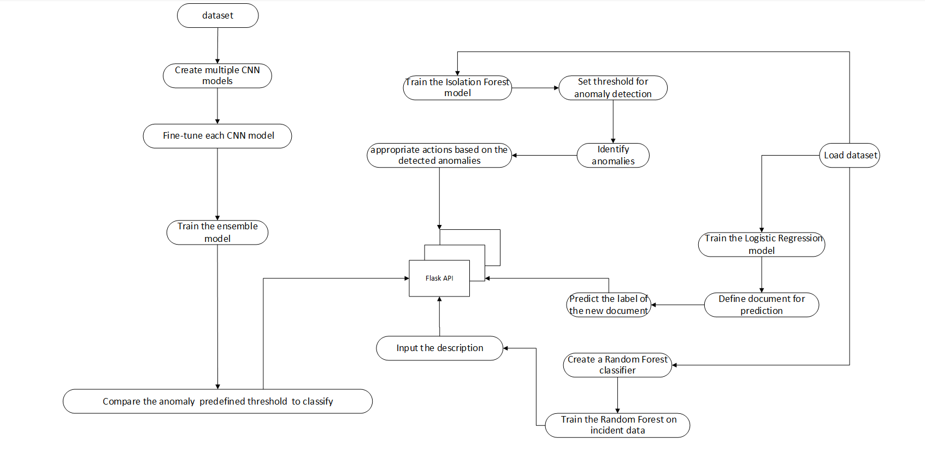
OVERALL SYSTEM DIAGRAM
08/02/2023

Slide 8

SAFEGUARDING SYSTEMS BY IDENTIFYING
UNUSUAL USER PATTERNS
AHAMED RR | IT20650902
CYBERSECURITY
IT20650902 | Ahamed RR | TMP-2023-24-082
08/02/2023

Slide 9

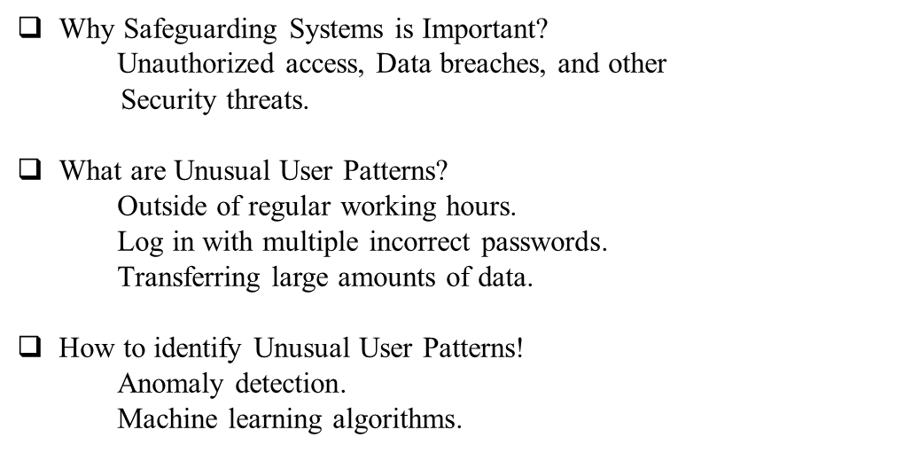
BACKGROUND
Using statistical analysis to identify patterns that deviate from the norm
Using machine learning algorithms
IT20650902 | Ahamed RR | TMP-2023-24-082
08/02/2023

Slide 10
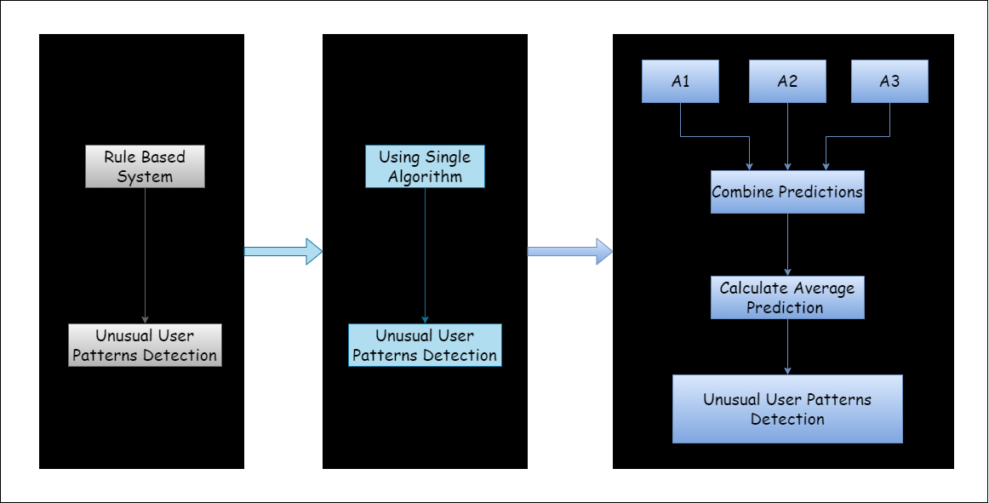
RESEARCH GAP
Despite the significant progress in anomaly detection algorithms, there is still a research gap in combining multiple algorithms to improve the accuracy of unusual user patterns predictions.
IT20650902 | Ahamed RR | TMP-2023-24-082
08/02/2023

Slide 11
RESEARCH PROBLEM
Safeguarding systems to identify unusual user patterns.
Challenge of balancing false positives and false negatives when detecting anomalies in user patterns.
Solution : Our research aims to address these challenges by combining multiple anomaly detection algorithms and aggregating their results to make the final anomaly predictions on user patterns.
IT20650902 | Ahamed RR | TMP-2023-24-082
08/02/2023

Slide 12


OBJECTIVE
Sub-Objectives
Implement anomaly detection in user behavior data
Explore ensemble methods to combine multiple anomaly detection algorithms.
Aggregate the results of ensemble methods to make the final anomaly predictions.
Improve the overall detection performance for potential security threats and abnormal activities.
Ensuring the accuracy of the prediction
Main Objective
Safeguarding Systems by Identifying Unusual User Patterns
IT20650902 | Ahamed RR | TMP-2023-24-082
08/02/2023

Slide 13
METHODOLOGY
IT20650902 | Ahamed RR | TMP-2023-24-082
08/02/2023

Slide 14
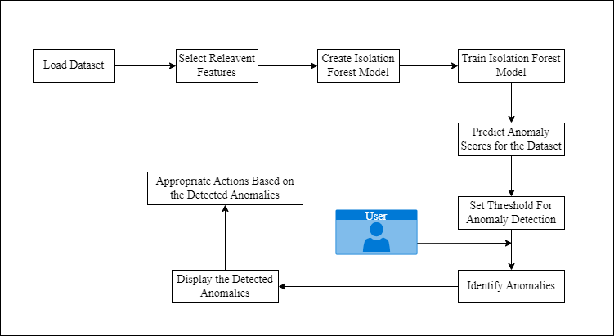
SYSTEM DIAGRAM
IT20650902 | Ahamed RR | TMP-2023-24-082
08/02/2023

Slide 15



TECHNOLOGIES
1
Machine Learning
2
Flask API
3
Python
IT20650902 | Ahamed RR | TMP-2023-24-082
08/02/2023

Slide 16


REQUIREMENTS
Functional Requirements
Non-Functional Requirements
Identify Unauthorized Access
Identify Session durations
Login Frequency
Reliability
Maintainability
Security
IT20650902 | Ahamed RR | TMP-2023-24-082
08/02/2023

Slide 17
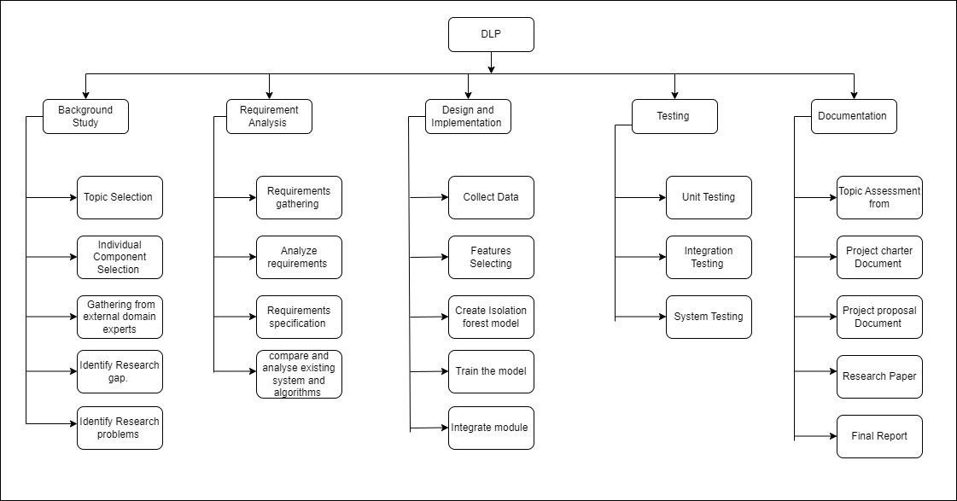
WORK BREAKDOWN STRUCTURE
IT20650902 | Ahamed RR | TMP-2023-24-082
08/02/2023

Slide 18
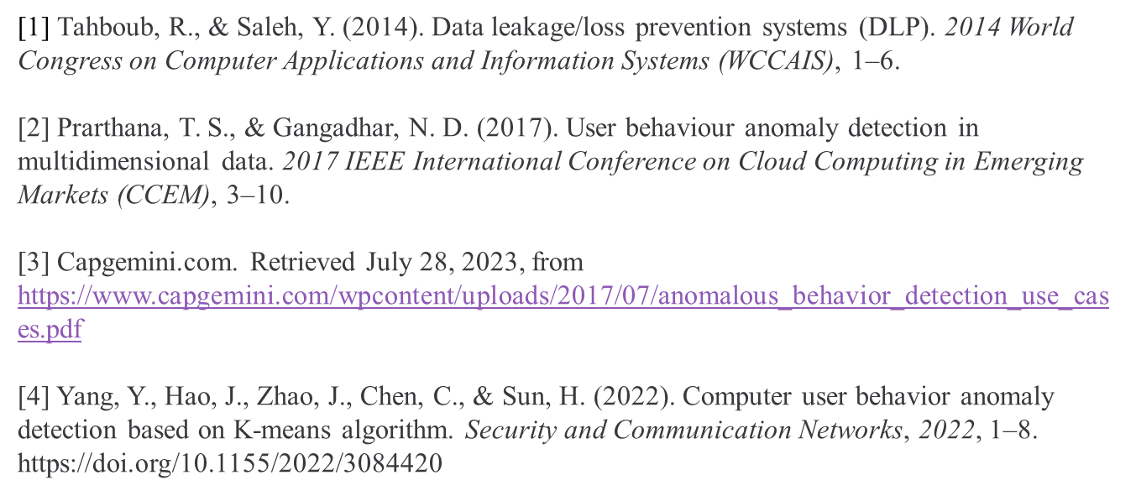
REFERENCES
IT20650902 | Ahamed RR | TMP-2023-24-082
08/02/2023

Slide 19

UTILIZING NLP TECHNIQUES FOR ENHANCED DATA PROTECTION
FAYAS ACM | IT20637828
CYBERSECURITY
IT20637828 | Fayas ACM | TMP-2023-24-082
08/02/2023

Slide 20

INDUCTION AND BACKGROUND
Identifying Sensitive Information in Documents
Importance of Protecting Data from Unauthorized Access
NLP techniques offer a powerful way to extract sensitive information from documents.
Analyzing text data uncovers insights and identifies personal information.
IT20637828 | Fayas ACM | TMP-2023-24-082
08/02/2023

Slide 21
RESEARCH GAP
Existing System using technology without NLP Techniques
Need for Comprehensive Approaches
Challenges with Multilingual Documents
Limitations in Handling Document Formats
The system analyzes the document word by word.
IT20637828 | Fayas ACM | TMP-2023-24-082
08/02/2023

Slide 22
RESEARCH PROBLEM
Difficulty in identifying sensitive information from the uploaded document.
Advancements in NLP will drive improved accuracy and efficiency in sensitive information extraction.
Provide an awareness message or alert to users, notifying them about sensitive information.
IT20637828 | Fayas ACM | TMP-2023-24-082
08/02/2023

Slide 23
OBJECTIVE
Sub-Objectives
Implementing Natural Language Processing (NLP) techniques to analyze documents.
Ensuring the system's accuracy in identifying and flagging sensitive information.
Providing user-friendly interfaces for efficient interaction and understanding of alerts.
Main Objective
To develop an intelligent system that raises user awareness about sensitive information in documents and alerts them appropriately.
IT20637828 | Fayas ACM | TMP-2023-24-082
08/02/2023

Slide 24
METHODOLOGY
IT20637828 | Fayas ACM | TMP-2023-24-082
08/02/2023

Slide 25
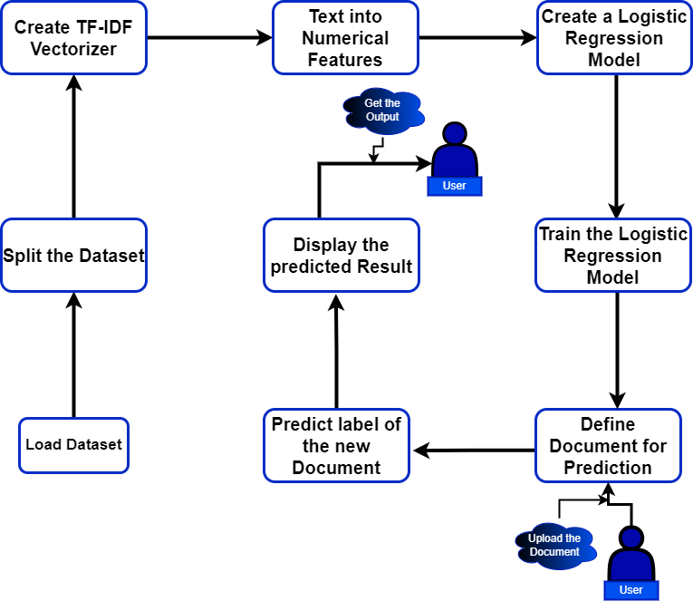
SYSTEM DIAGRAM
IT20637828 | Fayas ACM | TMP-2023-24-082
08/02/2023

Slide 26



TECHNOLOGIES AND TOOLS
1
Technologies
Natural Language Processing (NLP)
Feature Extraction Technology
Supervised learning algorithm​
2
Programming languages
Python
3
Tools
Pycharm
Visual Studio code
Python
IT20637828 | Fayas ACM | TMP-2023-24-082
08/02/2023

Slide 27
REQUIREMENTS
Functional Requirements
Non Functional Requirements
Identify the sensitive Information.
Data file handling.
Analyze Data and Alerting.
High processing rate
Speed
Reliability
Scalability
Security
IT20637828 | Fayas ACM | TMP-2023-24-082
08/02/2023

Slide 28
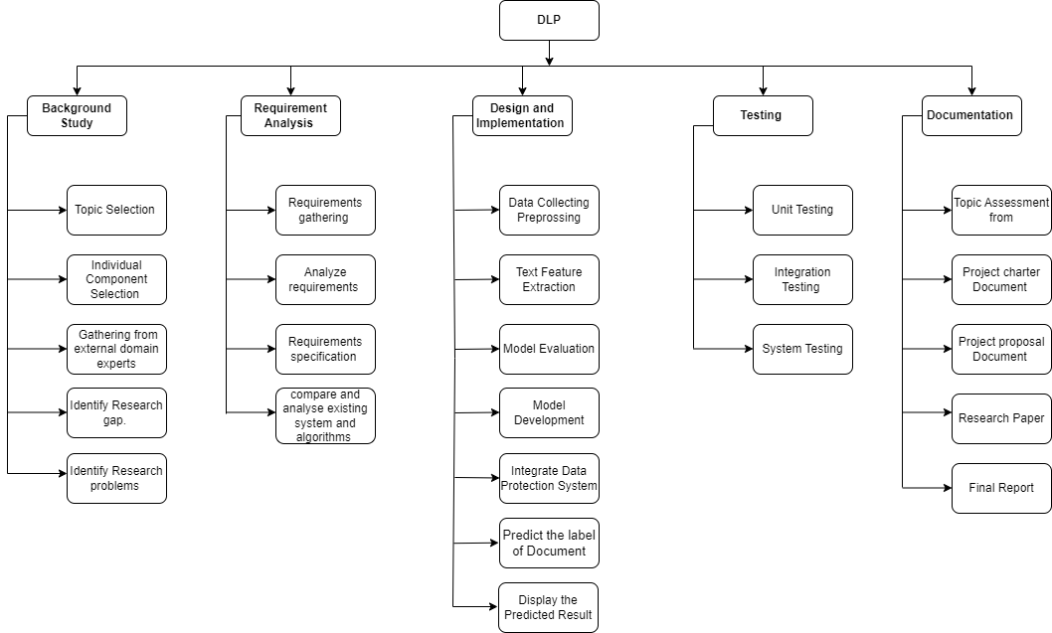
WORK BREAKDOWN STRUCTURE
IT20637828 | Fayas ACM | TMP-2023-24-082
08/02/2023

Slide 29
REFERENCES
[1] Martinelli, F., Marulli, F., Mercaldo, F., Marrone, S., & Santone, A. (2020). Enhanced privacy and data protection using natural language processing and artificial intelligence. 2020 International Joint Conference on Neural Networks (IJCNN), 1–8.
[2] Vaidya, N. (n.d.). 5 natural language processing techniques for extracting information. Aureusanalytics.com. Retrieved August 1, 2023, from https://blog.aureusanalytics.com/blog/5-natural-language-processing-techniques-for-extracting-information
[3] (N.d.). Researchgate.net. Retrieved August 1, 2023, from https://www.researchgate.net/publication/326264437_Natural_Language_Processing_for_Information_Extraction
IT20637828 | Fayas ACM | TMP-2023-24-082
08/02/2023

Slide 30

Classify data leakage level with machine learning
Keshani SK | IT20299002
CYBERSECURITY
IT20299002 | Keshani SK | TMP-2023-24-082
08/02/2023

Slide 31

BACKGROUND
With the surge in digitization, businesses are increasingly relying on emails for internal and external communication, making them prime targets for data breaches and unauthorized disclosures.
Traditional email systems employ static rule-based methods for content filtering, which often lead to false positives and miss nuanced data leak attempts.
Machine Learning (ML) offers the promise of dynamic, adaptive, and context-aware data classification, allowing for a more effective identification of potential data leakage.
IT20299002 | Keshani SK | TMP-2023-24-082
08/02/2023

Slide 32
RESEARCH GAP
01. Existing - Current DLP solutions mostly rely on static keyword dictionaries and predefined rules for classifying email content, which can be easily bypassed with slight modifications in the data.
Novelty – Incorporating machine learning algorithms can provide dynamic analysis, adapting to new data leak patterns and reducing the reliance on manual rule updates.
02. Existing - Existing systems often lack the adaptability to evolve with changing patterns of data leakage, leading to decreased efficiency over time.
Novelty - A model that not only classifies but also ranks the severity of potential data leaks can provide organizations with a prioritized response strategy, ensuring resources are allocated effectively.
IT20299002 | Keshani SK | TMP-2023-24-082
08/02/2023

Slide 33
RESEARCH PROBLEM
Increasing Sophistication of Data Breaches: Modern cyber-attacks are becoming more sophisticated, making traditional DLP methods less effective at detecting and preventing data leaks.​
High False Positive Rates: Current systems often generate numerous false alerts, leading to reduced efficiency and desensitization to potential real threats.​
Lack of Contextual Understanding: Many DLP solutions fail to understand the deeper context of emails, leading to ineffective classification and potential data leakage.​
Scalability and Performance Issues: As organizations grow and handle larger volumes of emails, many DLP systems struggle to maintain performance, resulting in potential delays or missed threats.​
IT20299002 | Keshani SK | TMP-2023-24-082
08/02/2023

Slide 34
OBJECTIVE
Sub-Objectives
Helps in identifying any overfitting issues, ensuring the model performs well on actual emails and not just the training data.
Facilitates easier monitoring and management of classified emails, enabling timely responses to potential data leak threats.
Enables immediate action on potential risks, reducing the window of vulnerability when sensitive data might be exposed.
Main Objective
The core objective of classifying data leakage level using machine learning in a DLP system is to predict the potential impact of a data leak, enabling organizations to respond appropriately and minimize damage.
IT20299002 | Keshani SK | TMP-2023-24-082
08/02/2023

Slide 35
METHODOLOGY
IT20299002 | Keshani SK | TMP-2023-24-082
08/02/2023

Slide 36
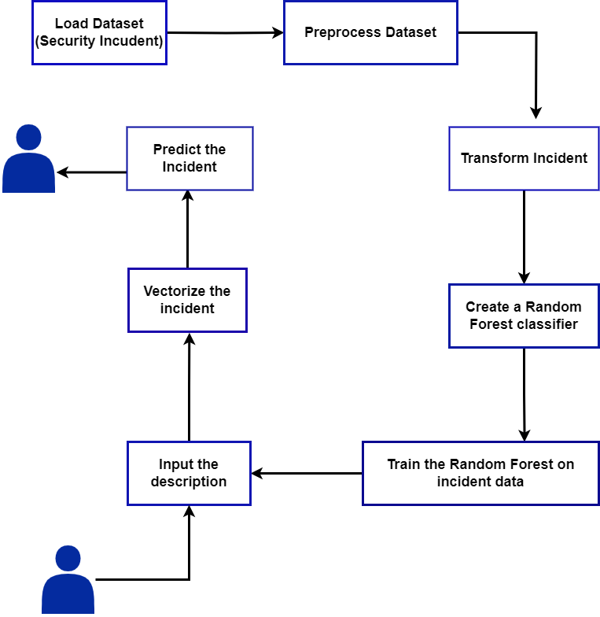
SYSTEM DIAGRAM
IT20299002 | Keshani SK | TMP-2023-24-082
08/02/2023

Slide 37



TECHNOLOGIES
Machine Learning
Supervised learning algorithm​
Programming languages (Python)​
IT20299002 | Keshani SK | TMP-2023-24-082
08/02/2023

Slide 38
REQUIREMENTS
Functional Requirements​
Non-Functional Requirements
Data Collection​​​
Real-time Analysis​
Interactive Dashboard​
Integration Capability​
Alert Mechanism​
Performance​​
Security​​
Reliability​​
Usability​​
Accuracy
Scalability
IT20299002 | Keshani SK | TMP-2023-24-082
08/02/2023

Slide 39

WORK BREAKDOWN STRUCTURE
IT20299002 | Keshani SK | TMP-2023-24-082
08/02/2023

Slide 40
REFERENCES
1] Kumar, R. (n.d.). Data Leakage Detection. Globaljournals.org. Retrieved July 29, 2023, from https://globaljournals.org/GJCST_Volume17/3-Data-Leakage-Detection.pdf​
[2] Paul, M., & Medhe, K. (2019). Using machine learning to detect anomalies in internet browsing pattern of users. SSRN Electronic Journal. https://doi.org/10.2139/ssrn.3511054​
[3](N.d.-a).Researchgate.net.RetrievedJuly29,2023,from
https://www.researchgate.net/publication/224146568_Data_Leakage_Detection​
[4](N.d.-b).Researchgate.net.RetrievedJuly29,2023,from https://www.researchgate.net/publication/286848340_A_Survey_of_Network_Anomaly_Detection_Techniques​
IT20299002 | Keshani SK | TMP-2023-24-082
08/02/2023

Slide 41

Abnormal Login Analysis for Email-Based DLP Systems
LOGU JJ | IT20638818
CYBERSECURITY
IT20638818 | Logu JJ | TMP-2023-24-082
08/02/2023

Slide 42

BACKGROUND
What is Abnormal Login Analysis?​
Importance of Abnormal Login Analysis?​
How can this support the overall output?​
Enhanced Malicious Image Detection
Early Threat Detection and Mitigation
Robustness against Adversarial Attacks
IT20638818 | Logu JJ | TMP-2023-24-082
08/02/2023

Slide 43
RESEARCH GAP
Limited Model Performance
Limited use of ensemble methods
Standard CNN architectures used for image classification.
In-depth implementation of ensemble methods for improved accuracy and robustness.
fine-tuning each CNN models
Exploration of advanced CNN architectures optimized for malicious image classification.
IT20638818 | Logu JJ | TMP-2023-24-082
08/02/2023

Slide 44

RESEARCH PROBLEM
Detection of Abnormal Login Patterns
Authentication Mechanisms
Real-time Monitoring and Alerts
User Behavior Profiling
IT20638818 | Logu JJ | TMP-2023-24-082
08/02/2023

Slide 45
OBJECTIVE
Sub-Objectives
user Behavior Profiling
Geographic Analysis
Sequential Login Analysis:
Main Objective
The primary goal of Abnormal Login Analysis in DLP systems is to promptly detect and respond to unusual or unauthorized login attempts, thereby safeguarding email data and preventing potential data breaches
IT20638818 | Logu JJ | TMP-2023-24-082
08/02/2023

Slide 46
METHODOLOGY
IT20638818 | Logu JJ | TMP-2023-24-082
08/02/2023

Slide 47
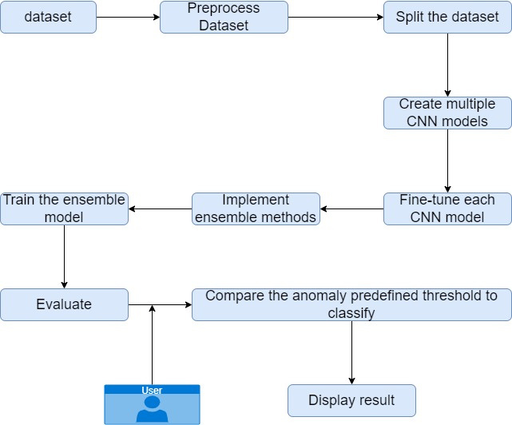
SYSTEM DIAGRAM
IT20638818 | Logu JJ | TMP-2023-24-082
08/02/2023

Slide 48



TECHNOLOGIES
1
Deep learning
2
Convolutional Neural Networks (CNNs)
3
CNN architecture
IT20638818 | Logu JJ | TMP-2023-24-082
08/02/2023

Slide 49
REQUIREMENTS
Functional Requirements
Non-Functional Requirements
Image Classification Model
CNN model creation
Fine-tuning Mechanism
Performance
Robustness:
Scalability
Security
IT20638818 | Logu JJ | TMP-2023-24-082
08/02/2023

Slide 50

WORK BREAKDOWN STRUCTURE
IT20638818 | Logu JJ | TMP-2023-24-082
08/02/2023

Slide 51
REFERENCES
[1] Krishnammal, M., & Raja, S. S. (2019). Deep learning based image classification and abnormalities analysis of MRI brain images. 2019 TEQIP III Sponsored International Conference on Microwave Integrated Circuits, Photonics and Wireless Networks (IMICPW), 427–431.
[2] Deepa, K., Adithyakumar, K. S., & Vinod, P. (2022). Malware Image Classification using VGG16. 2022 International Conference on Computing, Communication, Security and Intelligent Systems (IC3SIS), 1–6.
[3] Patil, V., Shetty, S., Tawte, A., & Wathare, S. (2023). Deep learning and binary representational image approach for malware detection. 2023 International Conference on Power, Instrumentation, Control and Computing (PICC), 1–7.
[4] https://www.researchgate.net/publication/356065872_Deep_Learning?Based_Image_Captioning Used_to_Recognize_Malicious_or_Emergency_Activity_in_an_Image - Image Captioning
Used to Recognize Malicious or Activity in an Image
IT20638818 | Logu JJ | TMP-2023-24-082
08/02/2023

Slide 52
COMMERCIALIZATION ​
(for the Overall System)​
Create a sales plan for the industry.
Design customer subscription plans.
Offer trial versions to known companies.
Provide excellent customer support.
08/02/2023

Slide 53
BUDGET​ (for the Overall System)​
Resources
Price(LKR)
Resources
Internet | 2000.00
Stationary Materials | 1000.00
Electricity | 2000.00
Hardware Equipment | 3000.00
Paper publish cost | 5000.00
Training & Testing cost | 4000.00
Total | 17000.00
08/02/2023

Slide 54
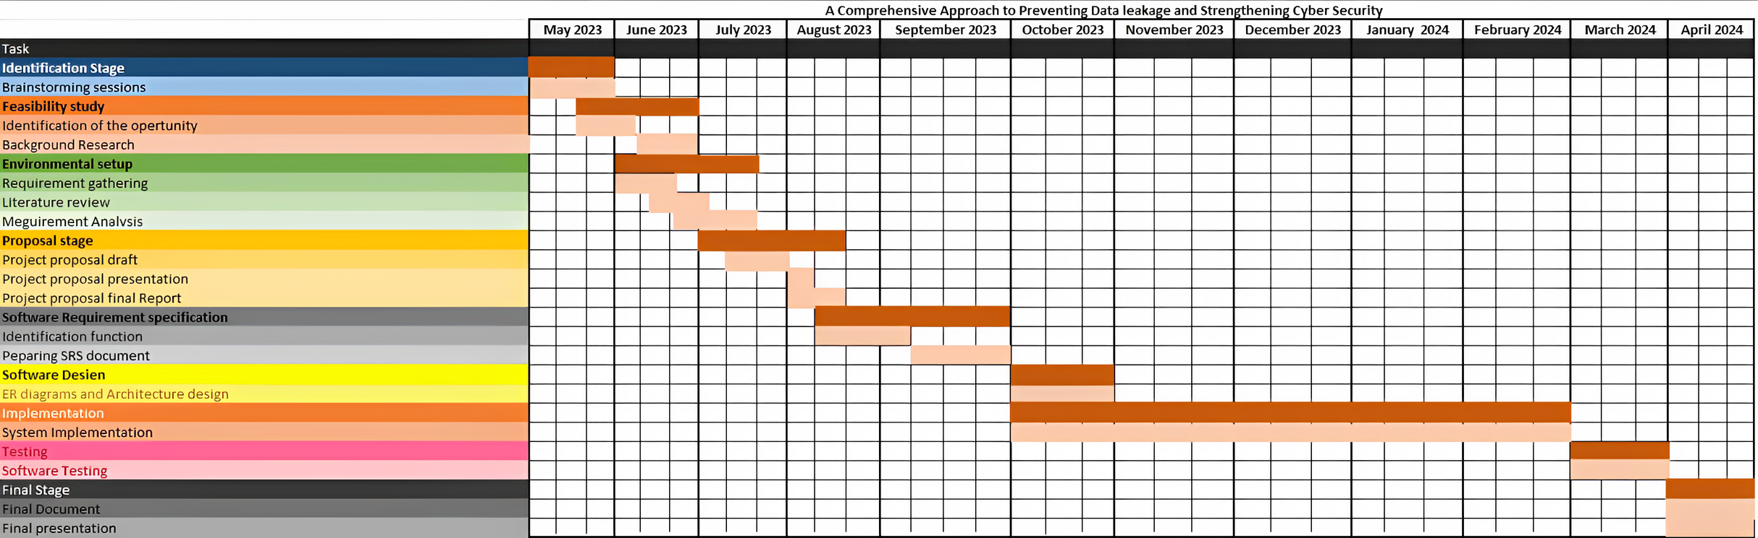
GANNT CHART
08/02/2023

Slide 55

Thank You

